Slide 1
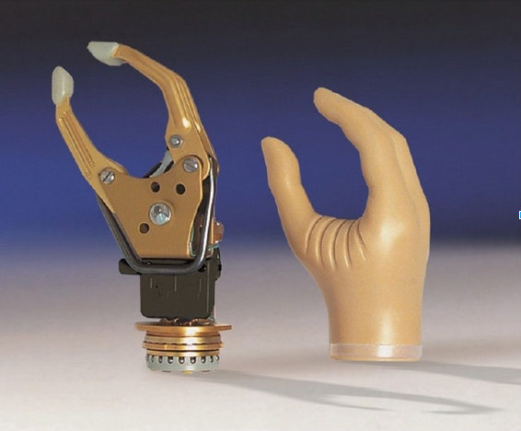
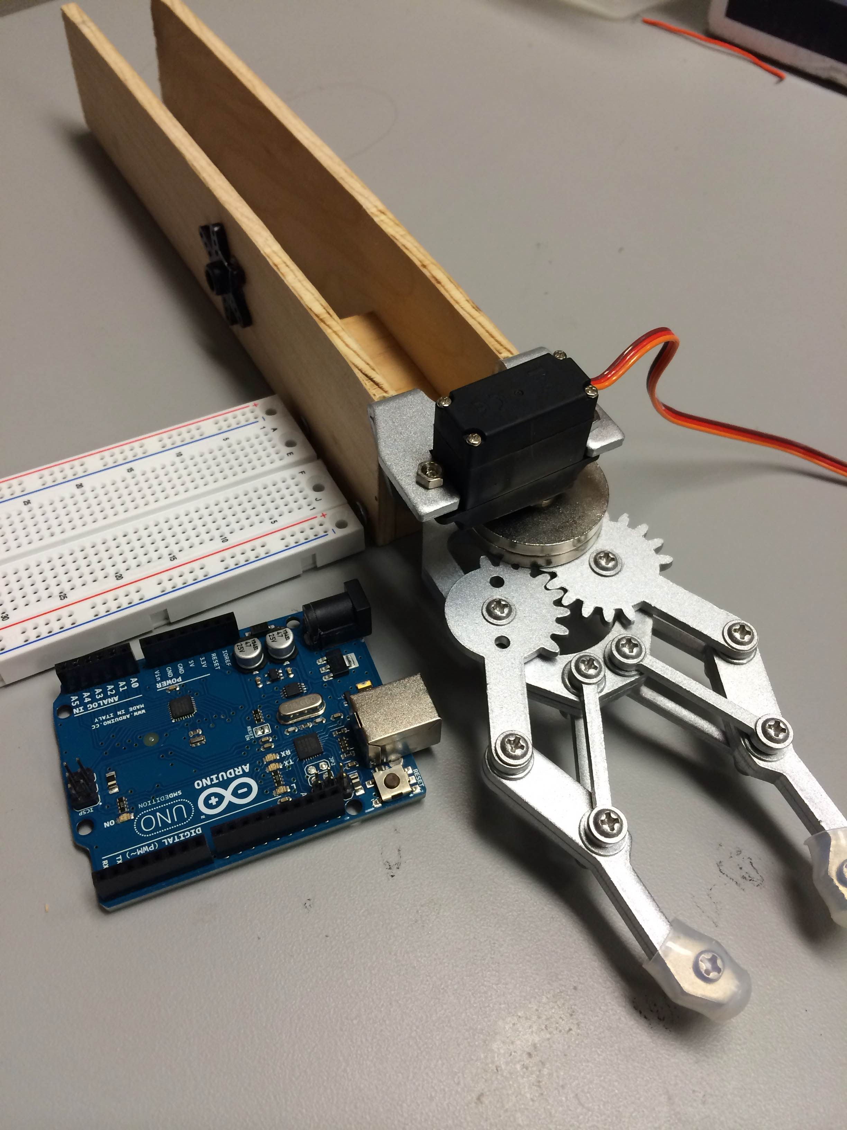
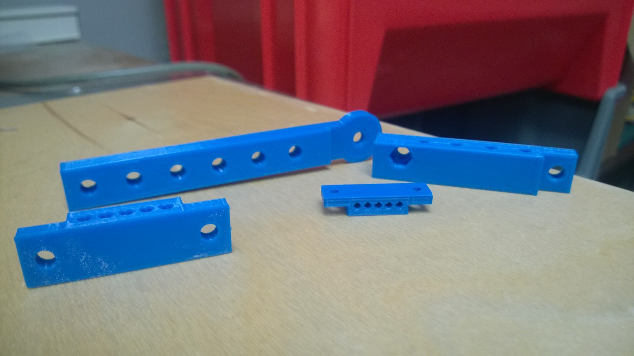
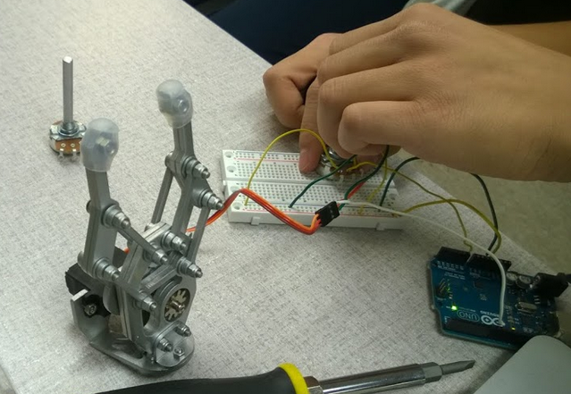
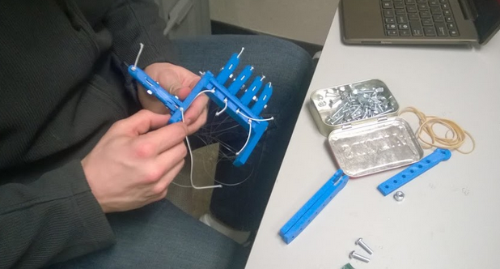
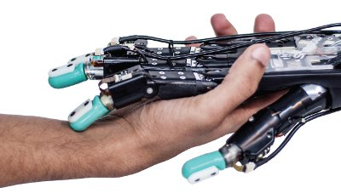
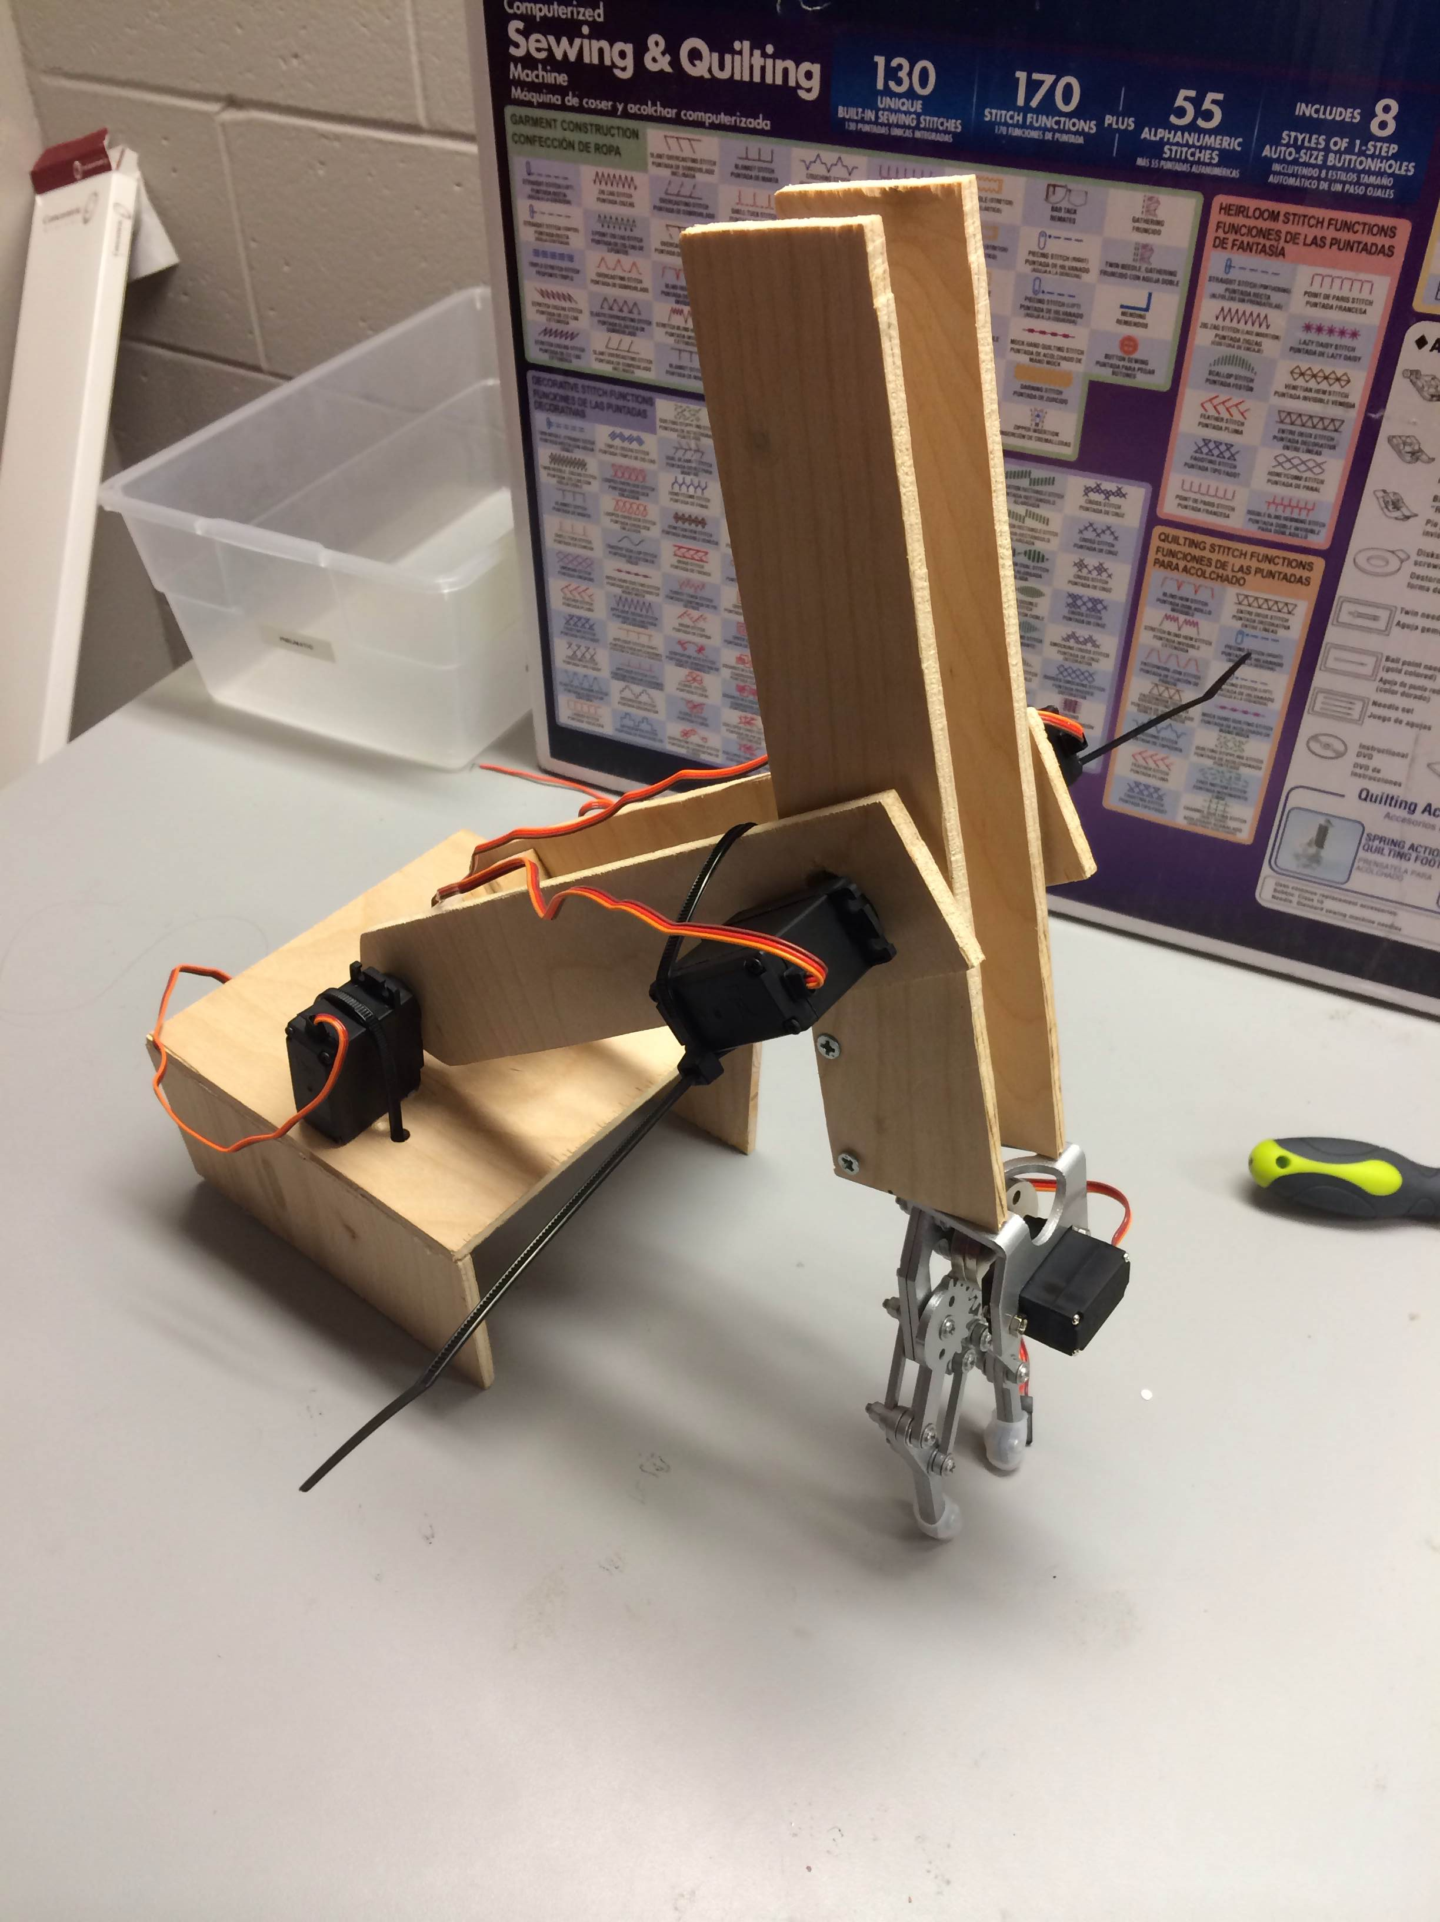
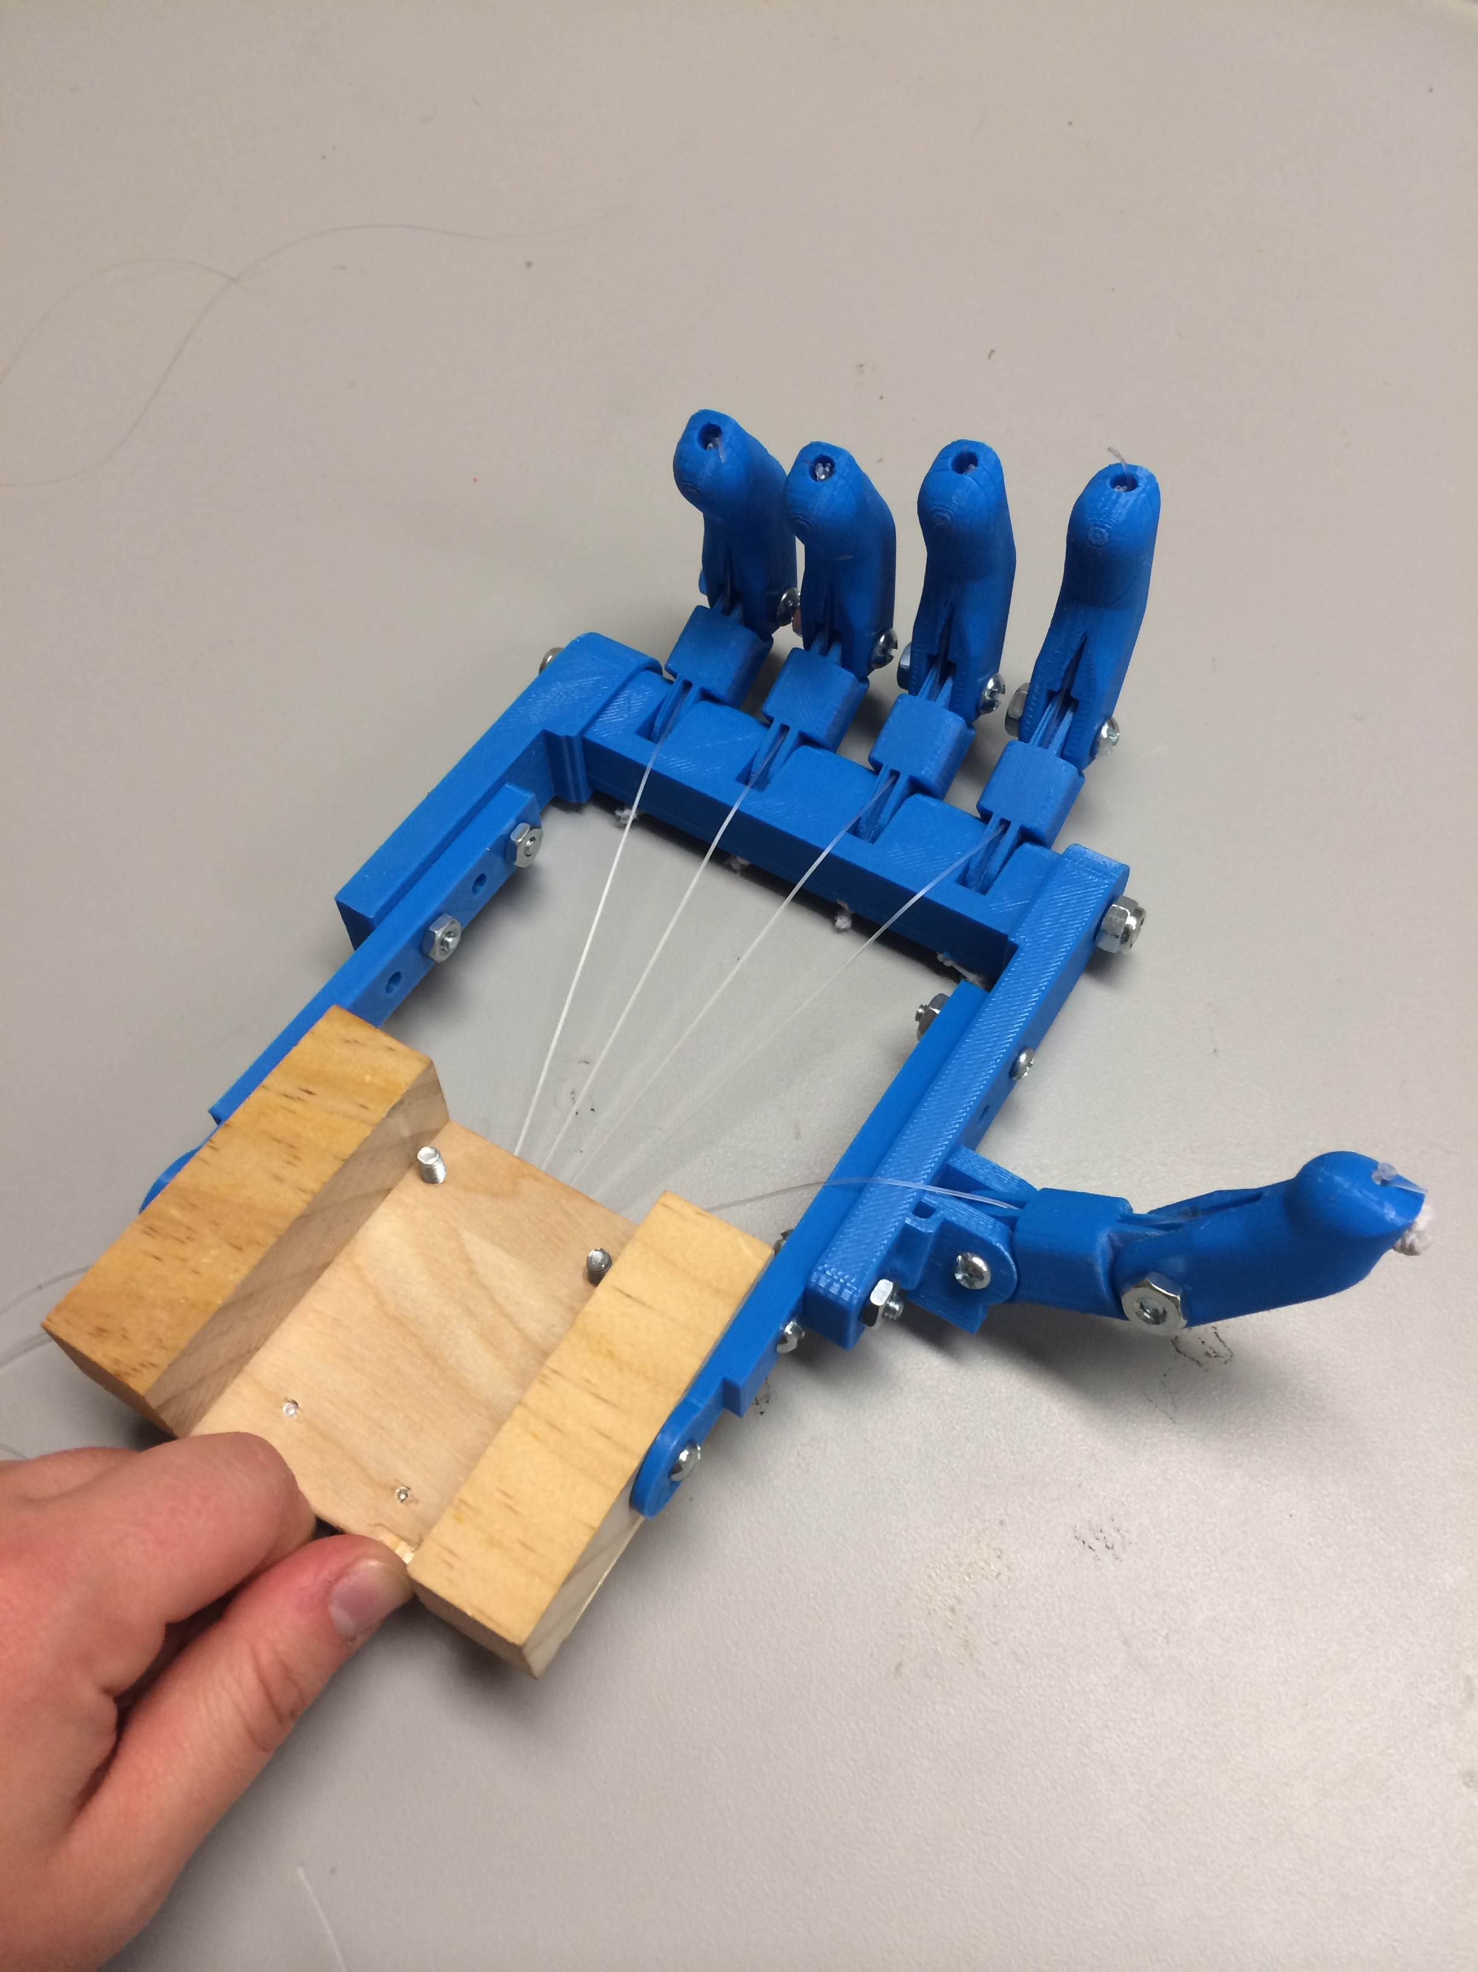
Links used:
Blade runner- http://www.thetimes.co.uk/tto/multimedia/archive/00368/118911061_boy_368650c.jpg
3rd world country: http://i1.ytimg.com/vi/SDYFMgrjeLg/0.jpg
Shaking prosthetic hand:
http://www.oandp.com/articles/images/2013-10/2013-10_04-01.jpg
Asthetics:
http://topnews.ae/images/Prosthetic-Arm.jpg
LENDING A HAND:
Active vs. Passive Prosthetics
BMES
Active
Passive
Advantages
More comfortable
Increased independence
Stronger grip force
More lifelike motion
Offers patient sensation
Drawbacks
Extremely expensive
Slower reaction time
Limited portability
Requires power supply
Advantages
Cosmetically appealing
Cheaper
Less maintenance
Freedom to use in wet or dirty environments
Drawbacks
Limited mobility
Stagnant in research
More fragile
No user feedback
Price Estimate based on Prosthetic Type:
Passive Prosthetics | $3,000
Body Powered Prosthetics | $7,000
Myoelectric Prosthetics | $15,000
Our 3D-printed hand | $15
Affordability in 3rd world countries
Multipurpose
i.e. sports and daily use
Future of
Prosthetics
User sensory feedback
Full dexterity
Durability
Aesthetically
appealing

